Slide 1

CS Waitlist Management System
CS410 Red Team

Slide 2







Team CORSICA
Anthony Baron
Patrick DeBerry
Latimer Gerle
Nicholas LoGioco
Bitaseme Mboe
Lookmai Rattana

Slide 3
Table of Content
Problem and Data 3
Case Study 9
Problem Statement 13
Solution 20
Competition and Component Diagram 25
Benefits of Solution and Problems with our Solution 32

Slide 4
PROBLEM & HISTORICAL DATA
Patrick DeBerry

Slide 5

History
Old Dominion University
Founded in 1930
Undergraduate enrolled: 19,612
Computer Science students enrolled:
Bachelor: 673
Masters: 111
PhD: 11
Record Systems:
I.S.I.S.
Banner (LeoOnline)

Slide 6
I.S.I.S.
ODU’s previous student records system
Supports students needs
Maintains student’s academic and financial records
Maintains administrative files
Allows to enroll students in courses and assess fees
Source: UC San Diego

Slide 7

Banner (LeoOnline)
ODU’s centralized academic and administrative records system
Web-based graphical user interface
Maintains all the academic and financial data for students
Allows users to change data with forms (with rights granted)
Source: Old Dominion University Website

Slide 8
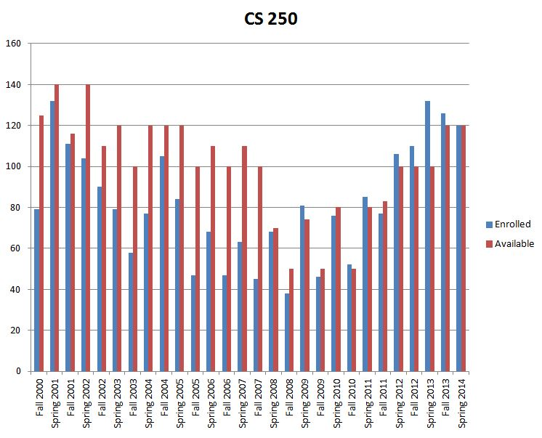

Student Enrollment for CS250
Stufor C
Data provided from LeoOnline, ODU's student information system

Slide 9

Not enough seats for students enrolled in some classes
PROBLEM

Slide 10
CASE STUDY
Lookmai Rattana
Notes:
My name is Lookmai and I like cats.

Slide 11

Current Waitlist
Available to Computer Science Department
Developed by Dr. Irwin Levinstein
Notes:
Currently only the Computer Science department has the option of using an automatic waitlist system, having been developed by Dr. Levinstein. The process is simple.

Slide 12
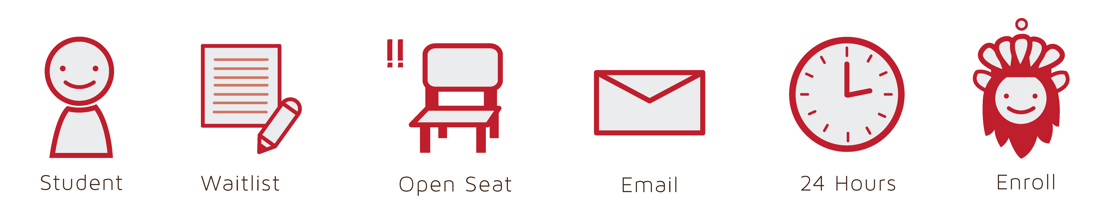
Simple Process
Student enlisted on the waitlist
System checks for open seat
Student is given 24 hours to response
System enrolls student into the class
Notes:
Once the student enlisted him/herself on the waitlist, the system would check for an open seat. When a seat is opened, the waitlist emails the first student on the list and gives the student a 24 hours period to response. If the student agrees to enroll in the class, the system checks the course’s availability with Banner. If the class is still available, the system would register the student into the class.

Slide 13

POTENTIAL
Useful to the rest of the university
Helps simplify the enrollment process
ISSUES
A student not on the list can enroll before the student can respond
Visibility of the list
Notes:
The process is simple and has a potential to become a very useful tool for the rest of the university. However, the current solution doesn’t address some of the important issues that comes with class registration process. For an example, what would happen when a student who is not on the waitlist registers for the class during the 24 hours wait period? The visibility of the waitlist is also an issue that need to be address.

Slide 14
PROBLEM STATEMENT
Bitaseme Mboe

Slide 15



Problem Characteristics
Time
Consuming
Confusing
Inefficient
Notes:
Confusing: Making a wait list more efficient in general is just downright confusing
Time Consuming: This isn’t a cakewalk. A better waitlist implementation is going to take quite a bit of time to develop
Inefficient: Self-explanatory.

Slide 16
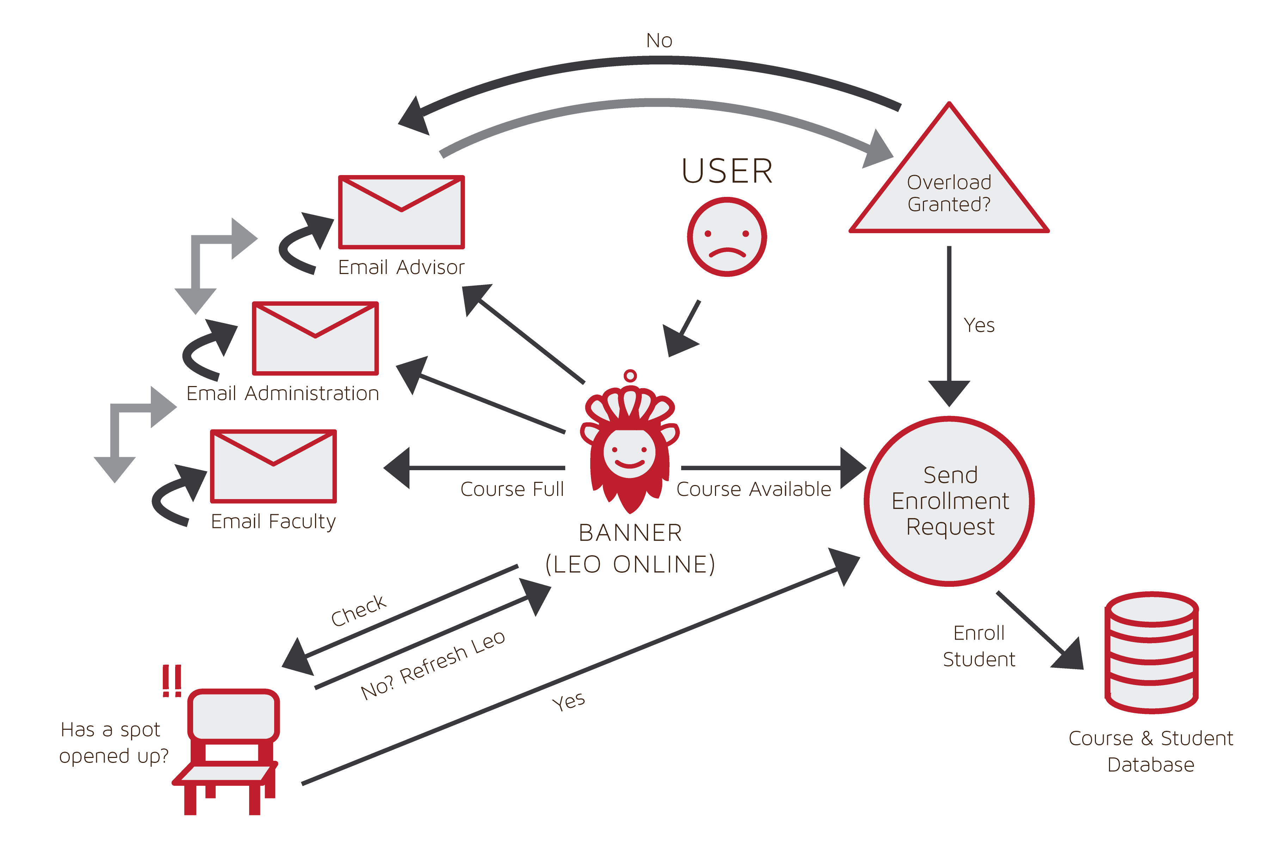

Current Process Flow

Slide 17
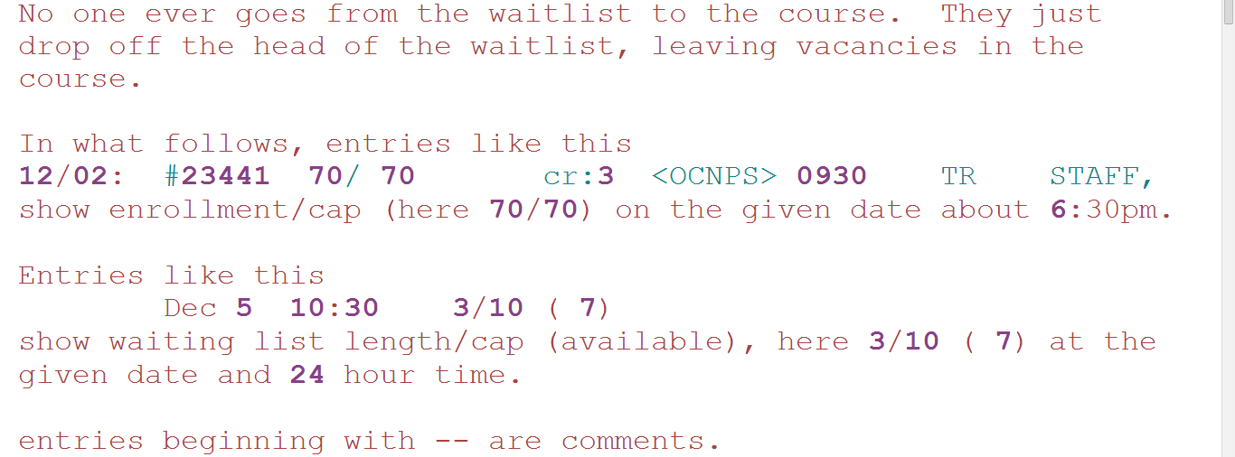
Waitlist History Log
Notes:
Credit: Dr. Levenstien

Slide 18
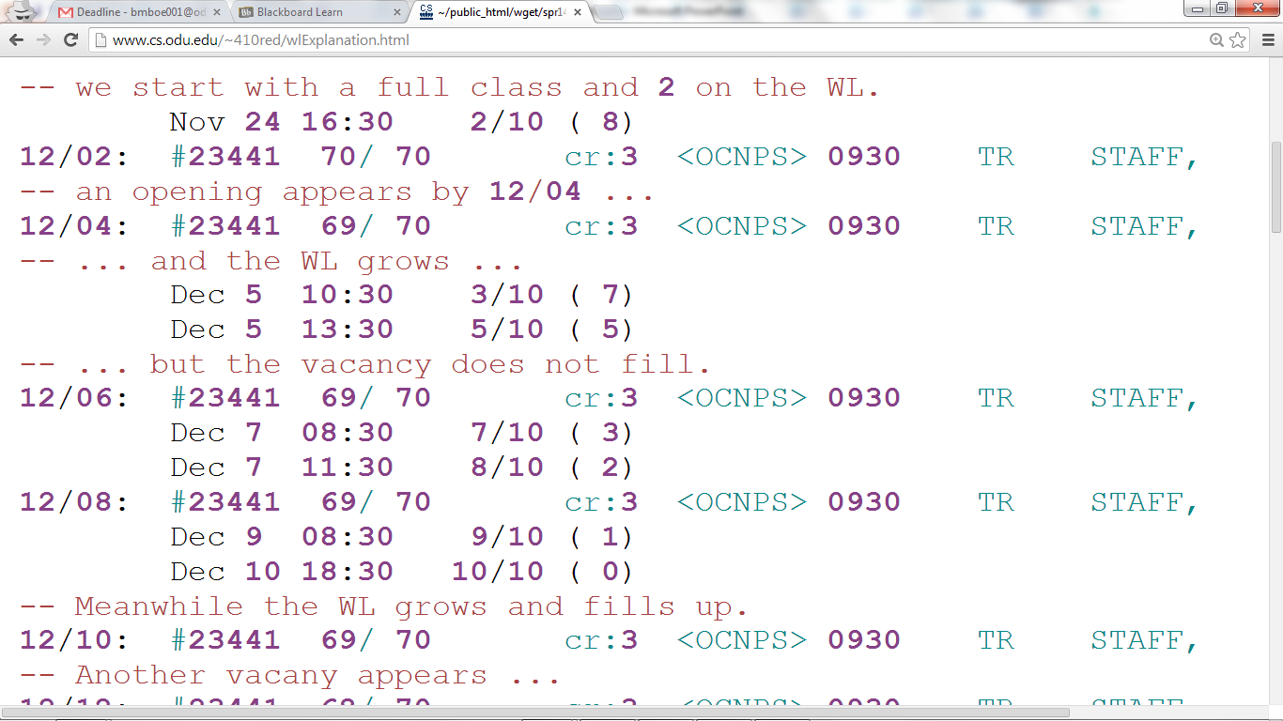
Waitlist History Log
Notes:
Credit: Dr. Levenstien

Slide 19
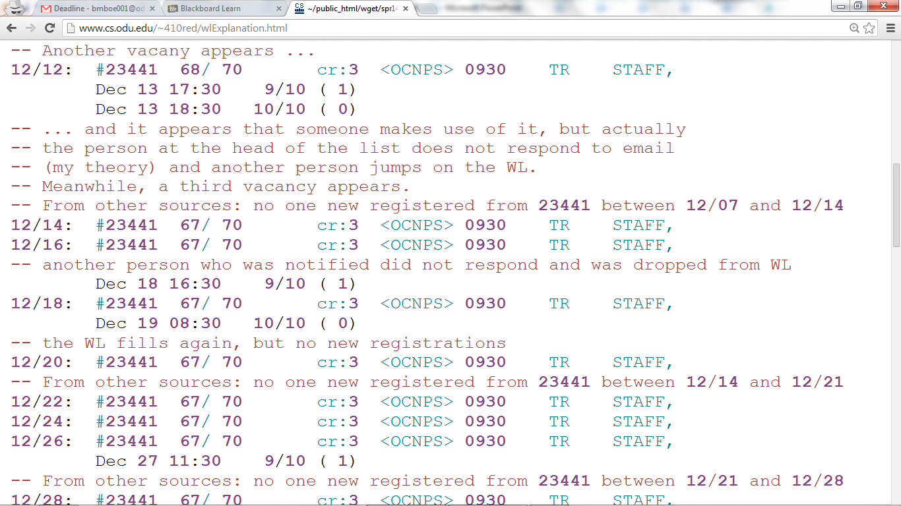
Waitlist History Log
Notes:
Credit: Dr. Levenstien

Slide 20
The current class enrollment system is inadequate
Notes:
Problem statement

Slide 21
SOLUTION
Anthony Baron
Notes:
This is Anthony. He’s chill.

Slide 22
Solution Statement
CORSICA will cause the enrollment process to become more efficient and streamline by
Emplacing course waitlist
To handle course fill ups during enrollment process
Having a waitlist communication system
Let students know a course has open by email, call, or text
Notes:
In order to solve this problem we will implement a waitlist system that handles course fill ups during the enrollment process. We’ve elected to include a communication system in order to reach students when a course opens up. They will be notified via: email, call, or text; (user specified) giving them an opportunity to sign up for their desired course.
Next slide please….

Slide 23

Solution Goals and Objectives
Streamline the course sign up process
Eliminate “panic factor”
Relieve Faculty during event of course fill up
Relieve Administration during event of course fill up
Notes:
What do we intend to achieve with this system? The enrollment process shall become more streamline and will eliminate the “panic factor” for students while relieving faculty and the University administration in the event of a course fill up. What exactly do I mean by “panic factor”? I would like to reference our current process flow diagram to illustrate my point.
Next slide please….

Slide 24

Notes:
BEFORE
Wow…..would you just look at how sad that user is? Its mildly depressing.
*pause for pity chuckles*
The diagram shows a scenario of a student attempting to sign up for a course they need in order to graduate on time. We all know how this process flow goes with no hang ups:
The student logs into myOdu
They then get into LeoOnline
Admissions, Registration, Student Records, Graduation Information tab
Choose Registration
Add/Drop/Withdraw Classes
Select your term
Find your class and enroll
Everyone is happy
However, it doesn’t always play out this way. A student will undoubtedly encounter a situation where they cannot sign up for a class because its full. Now I must admit I have acted just like that sad face user when something like this happened to me. I panicked; thinking that I wouldn’t be able to get into my course and I went through the paces of: Constantly refreshing to see if a spot opened up, Emailing my site director, Contacting my advisor (as Professor Brunelle may recall), and emailing the Professors who were instructing that course attempting to get in.
This whole ordeal is incredibly time consuming. How could most of this been avoided?
Next slide please….

Slide 25
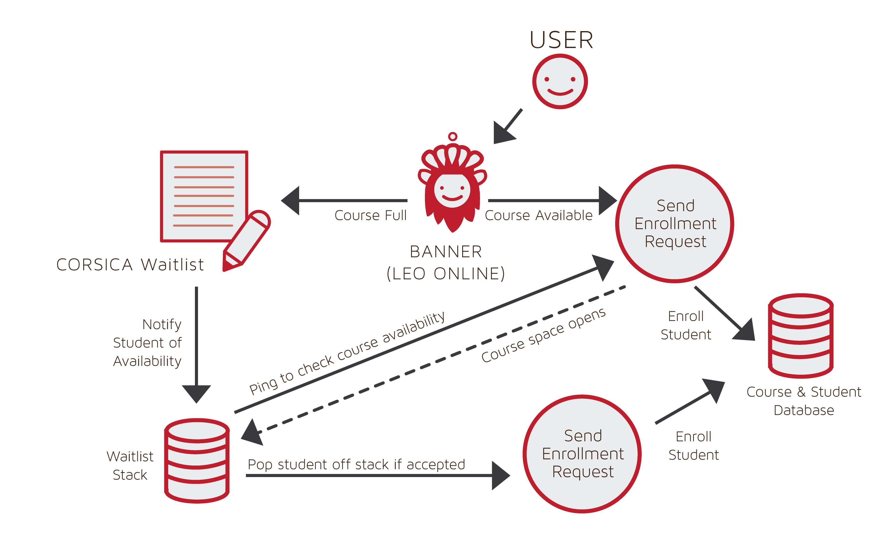

Improved Process
Notes:
AFTER
It seems our sad user has turned that frown upside down.
*pause for pity chuckles*
How does all of this work? Of course if there is a space available the student enrolls and that is the end of it. However, if a course is full then the student is placed on the waitlist and until they are notified, they don’t need to do anything The waitlist will constantly ping the course database to see when a seat becomes available. When this happens they are sent notifications via email, call, or text, informing them of their 12 hour window to sign up.
As you can see, after our system has been implemented everything becomes less hectic and more streamlined. Now if a student isn’t able to sign up for a course they can rest assured that they will placed in line to get it as soon as a space becomes available.
This allows them to go about their day instead of sitting at a computer constantly refreshing the site to see if a spot has opened; Not only has it improved their sign up experience but their Advisor, the University’s Faculty and Administration are not bothered by “panic” emails.
Now “Latimer” You can take over whenever you wish.

Slide 26
COMPETITION & MAJOR FUNCTIONAL COMPONENTS
Latimer Gerle

Slide 27
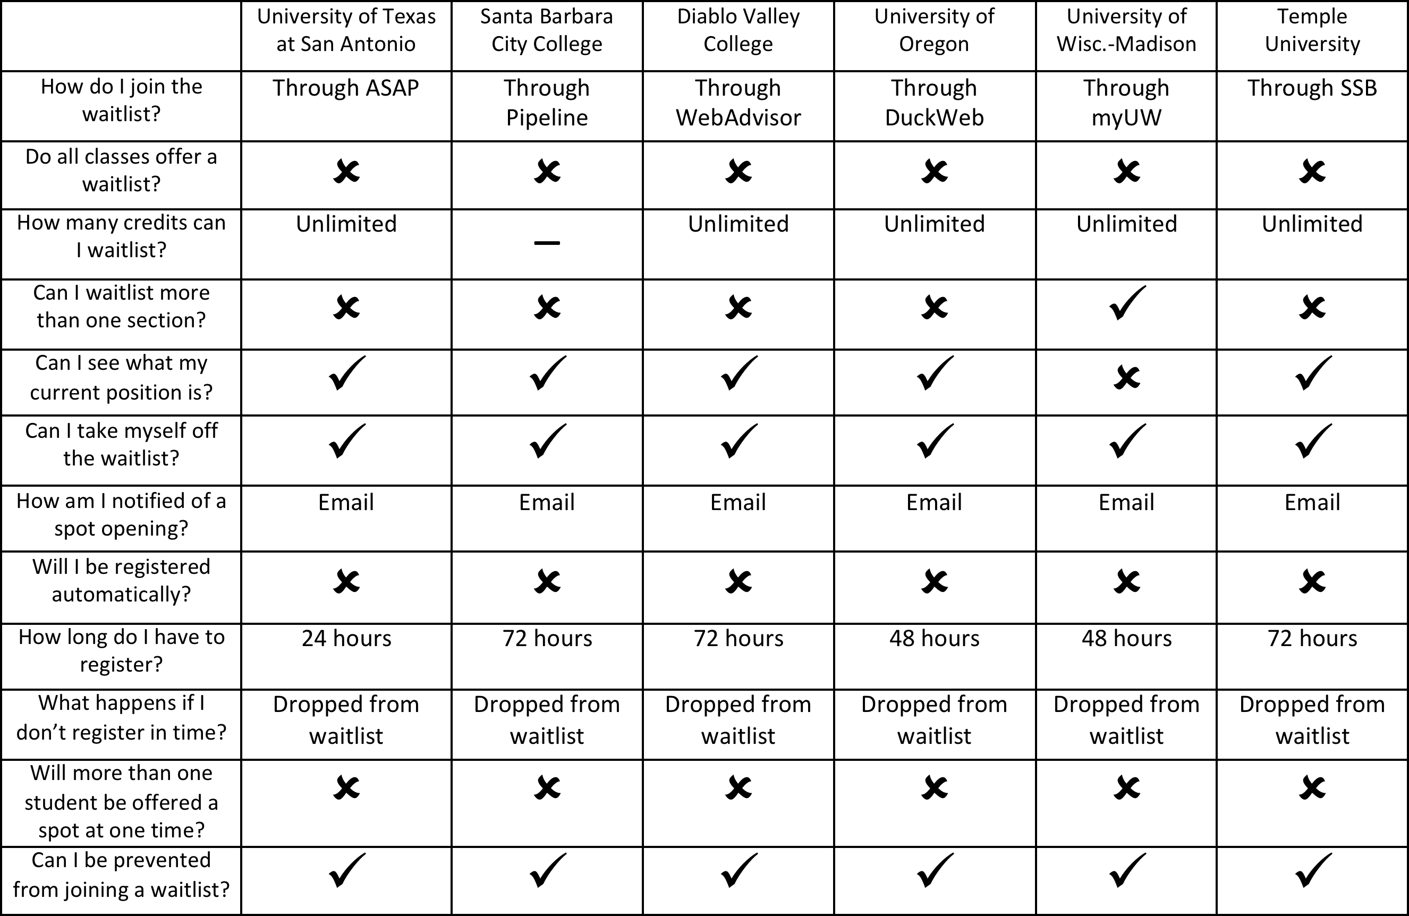
Competition Part I

Slide 28
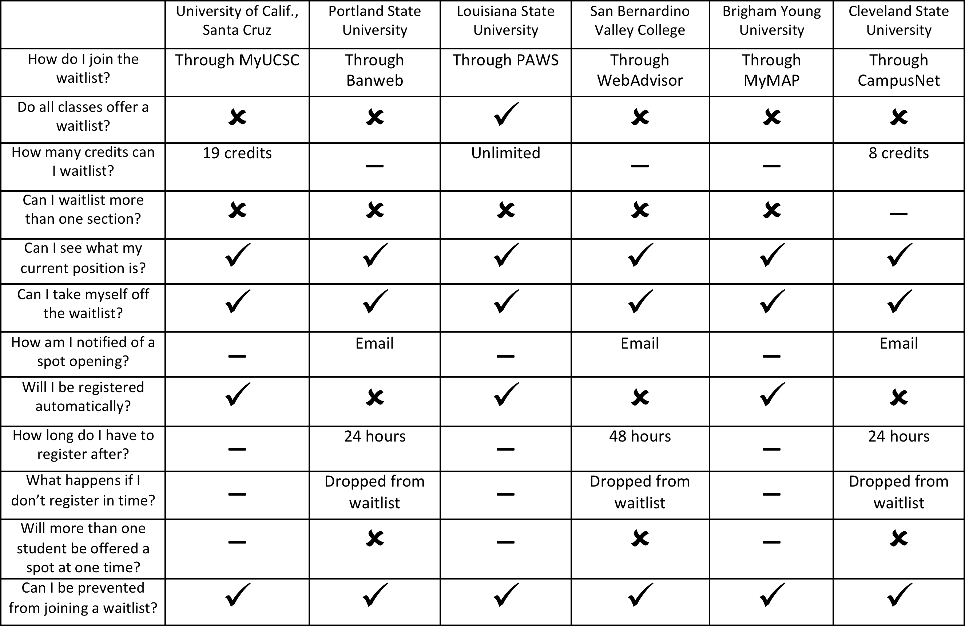
Competition Part II

Slide 29
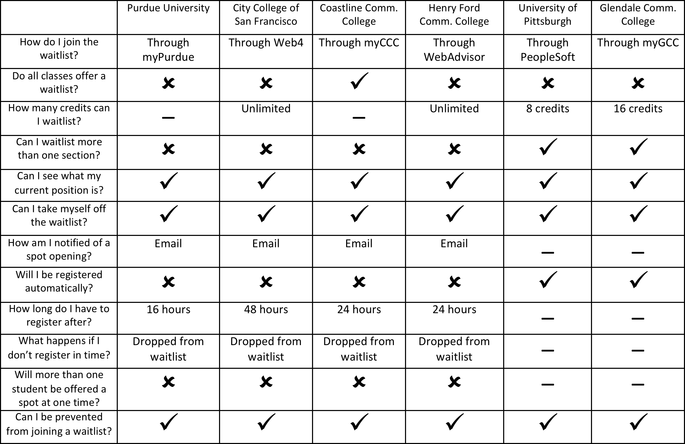
Competition Part III

Slide 30
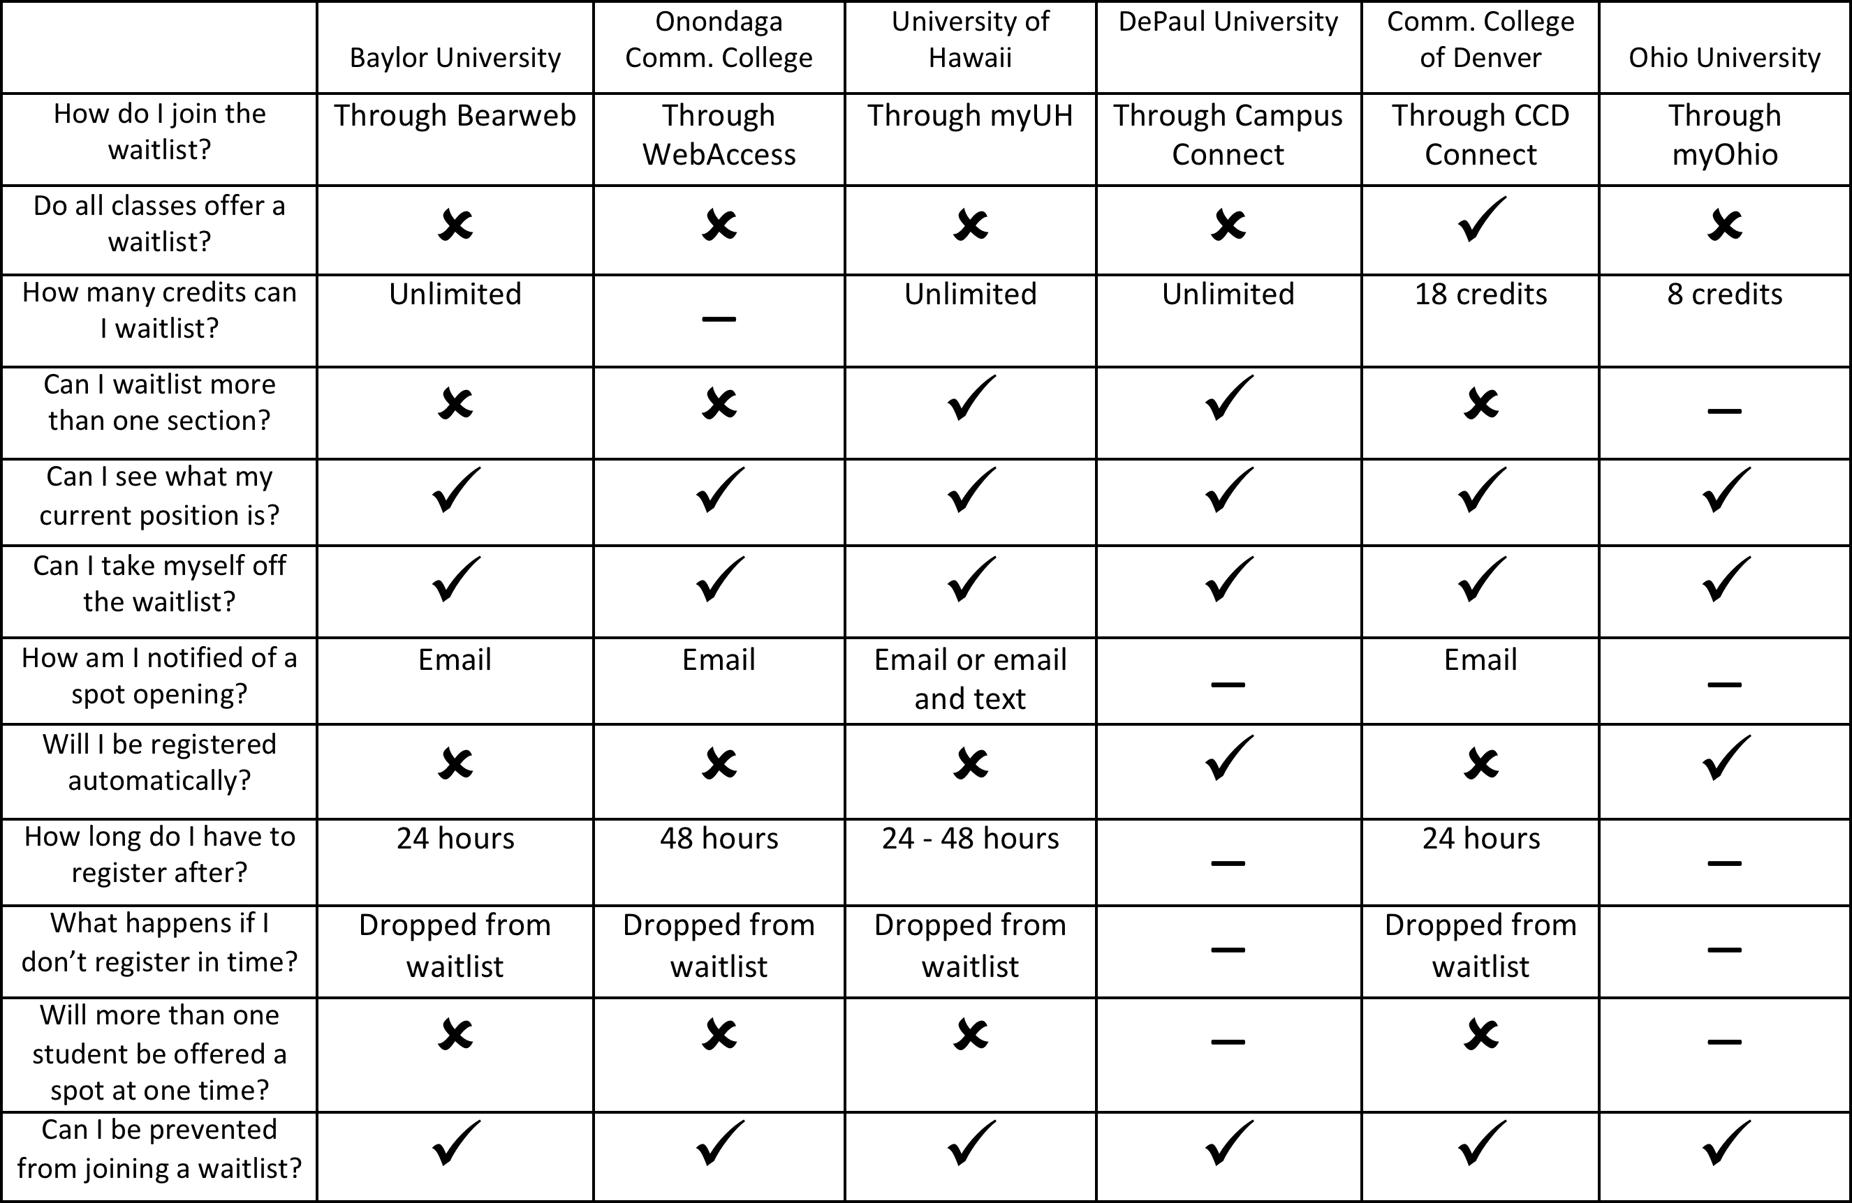
Competition Part IV

Slide 31
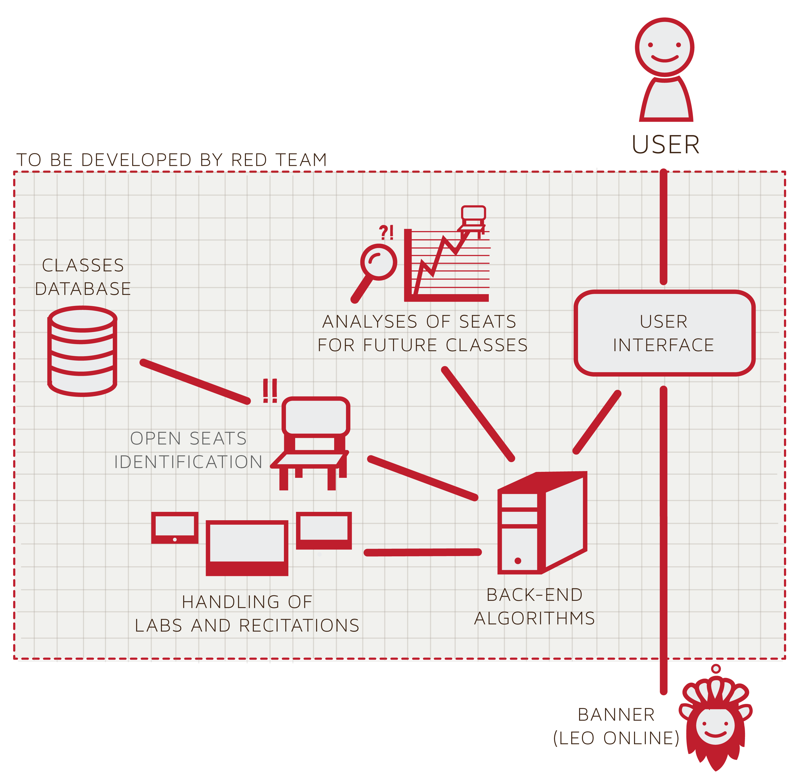

Major Functional Component Diagram

Slide 32

Required Components
Back-end algorithms
Open seat identification
Class database
Lab/recitation handling
Future class analyses
User interface

Slide 33
BENEFIT OF CORSICA
Nicholas LoGioco

Slide 34
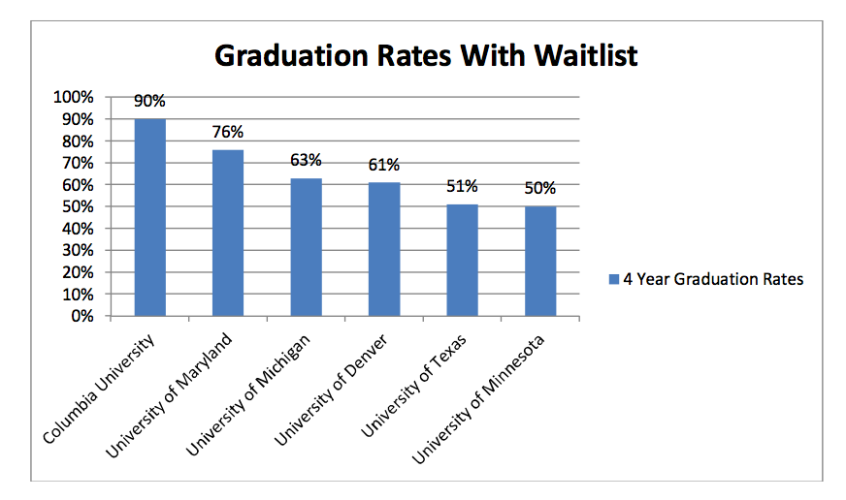

Slide 35

Benefits of CORSICA
Old Dominion University
4 Year Graduation Rate: 25% -Increase graduation rates
Decrease stress on faculty and students
Increase the amount of students enrolling into classes

Slide 36

Problems with Solution
System failure
Time issues with classes
Do we have a max waitlist cap
Students accidentally signing up for waitlist Do we allow multiple course waitlist?
Students not taking themselves off the waitlist

Slide 37
References
http://colleges.usnews.rankingsandreviews.com/best-colleges/old-dominion-university-3728
http://colleges.usnews.rankingsandreviews.com/best-colleges/columbia-university-2707
http://colleges.usnews.rankingsandreviews.com/best-colleges/university-of-denver-1371
http://colleges.usnews.rankingsandreviews.com/best-colleges/university-of-michigan-ann-arbor- 9092
http://colleges.usnews.rankingsandreviews.com/best-colleges/university-of-texas-austin-3658
http://colleges.usnews.rankingsandreviews.com/best-colleges/university-of-maryland-college- park-2103
http://colleges.usnews.rankingsandreviews.com/best-colleges/university-of-minnesota-twin- cities-3969

